Slide 1




COGNITIVEBOTICS
Artificial Intelligence for Autism Intervention
P.Jhansi N180693

Slide 2
TABLE OF CONTENTS
01
Abstract
02
Introduction
03
Related Works
04
Proposed Method

Slide 3
ABSTRACT
In this presentation, we showcase our project 'Personalized Autism Intervention Anytime Anywhere.' Through innovative technologies such as advanced gaze detection, pose imitation, and interactive voice detection within a chatbot, we've created a comprehensive platform to enhance attending and imitation skills in children with autism. Our developments provides personalized and engaging learning experiences. In recognizing the individuality of each child with autism, our project is dedicated to fostering inclusivity and personalized support, ensuring that every learning experience is uniquely tailored to their strengths and needs.

Slide 4
INTRODUCTION
Personalized Autism Intervention Anytime Anywhere
CognitiveBotics is an AI-powered assistive technology. It helps children with autism thrive in everyday situations. It brings together children, parents, and therapists on a single platform. Together they work in a safe and nurturing environment. With CognitiveBotics, children with autism can have more meaningful experiences in the real world.
Now In this project we have worked on learning objectives for autism childrem which improve their learning on attending skills and imitation skills

Slide 5
Understanding Autism
Autism is a spectrum disorder, showing up in different ways for different people, impacting how they interact with others."
People with autism might find communication challenging, engage in repetitive behaviors, and be sensitive to certain sounds or textures, emphasizing the importance of personalized understanding and support.
It's crucial to know that autism is just a part of who someone is, it doesn't define them. Accepting differences and fostering understanding lays the groundwork for meaningful inclusion.

Slide 6
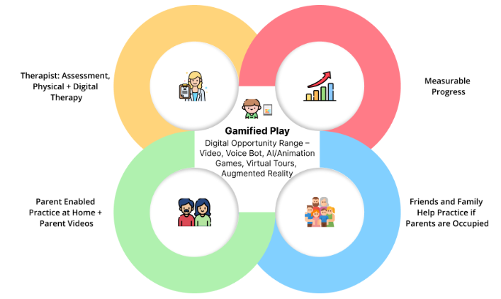
INTRODUCTION

Slide 7
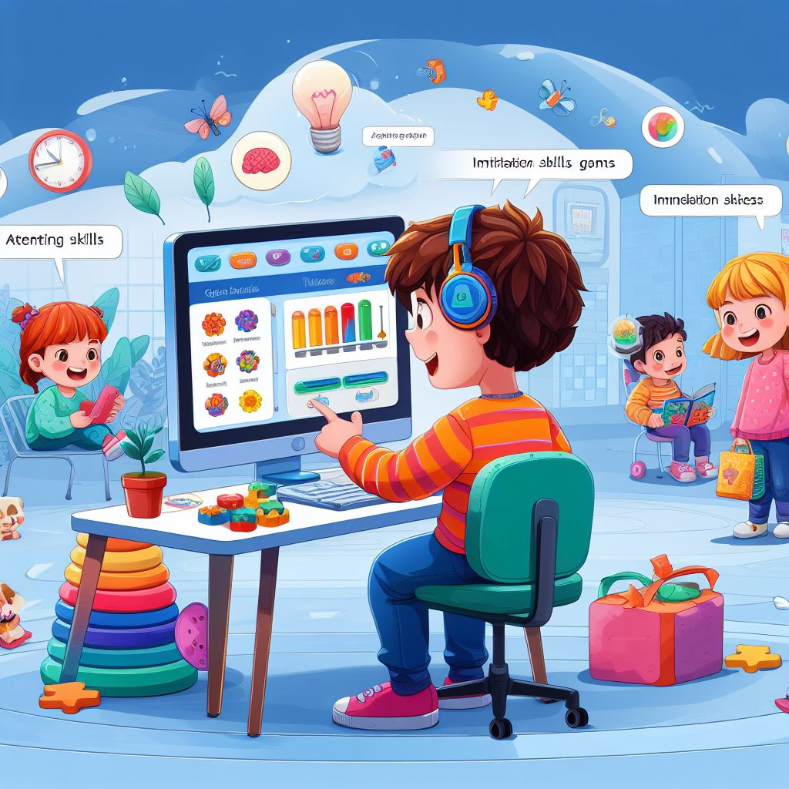
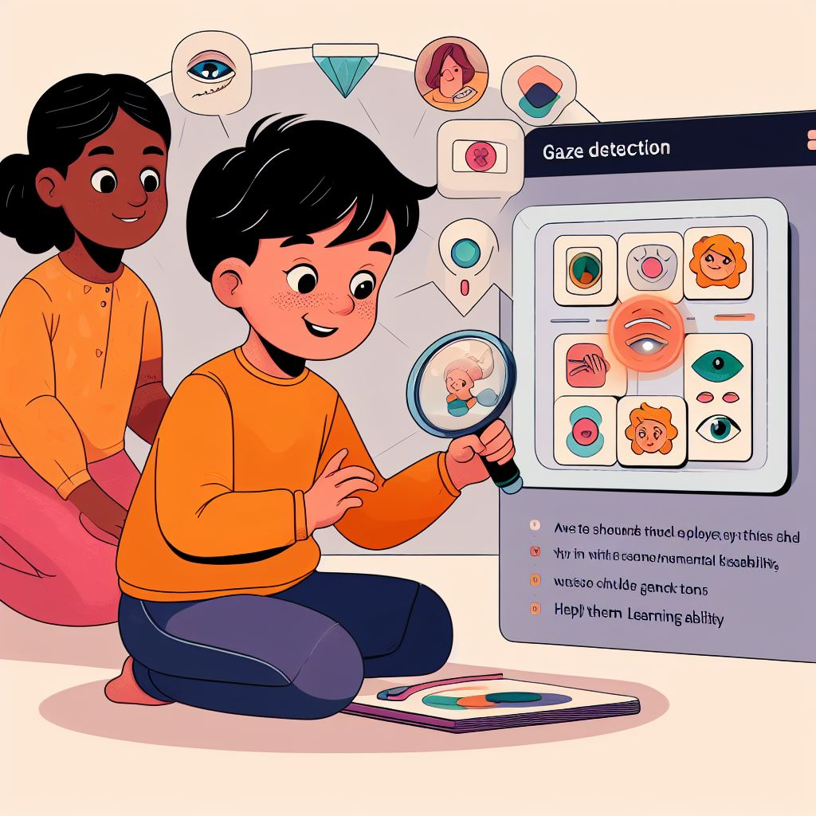
INTRODUCTION

Slide 8
INTRODUCTION
Learning Objectives
These are the skills we're focusing on: helping kids pay attention in social situations and encouraging them to imitate basic movements independently.
Attending Skills:
"Attending is like a social superpower! It's the first step for your child in any interaction. We've got some fun tips in a video to help your child learn to look your way and get ready for social adventures."
Imitation Skills:
"Imitation is a cool skill for your child to pick up. Since they learn a lot from exploring and their family, imitating basic movements becomes super important. This objective helps your child independently copy simple actions, like fine motor skills, and become a little explorer!"

Slide 9
INTRODUCTION
Motivation for Work:
Everyone Matters: We wanted to help all kids, including those with special needs, because we believe every child has great potential.We believe using technology, with a good understanding of what each child needs, can make the world better for them.
More Than Just Tech: Our goal was bigger than just using technology. We wanted to help kids with everyday challenges they face. And it is about making sure every child, no matter their abilities, feels included and supported.
Heart in the Work: We did this project because we care deeply about making a positive difference in the lives of kids with special needs.

Slide 10
INTRODUCTION
Connecting People: We aimed to bring kids, parents, and therapists together in one place to support and help each other.
Thriving in the Real World: We didn't just want kids to get by; we wanted them to do well in real-life situations.
Learning Important Skills: We focused on teaching kids skills like paying attention and imitating actions to help them learn and grow.
Learning Can Be Fun: We made sure our platform was not only helpful but also fun for kids, tailored to each child's unique needs.

Slide 11
RELATED WORKS
"Let's take a glance at some noteworthy research and projects related to our endeavor:"
Autism Intervention Technologies: Examining existing technologies tailored for autism intervention unveils a landscape rich with innovative apps, devices, and platforms dedicated to skill development in children with autism.
Gaze Detection in Education: In the realm of education, studies exploring gaze detection technologies shed light on their potential in creating inclusive and interactive learning environments, especially for children with neurodevelopmental disorders.

Slide 12
RELATED WORKS
Pose Detection for Motor Skills: Exploring research in pose detection, particularly focusing on motor skill development, provides insights into how similar technologies have been employed to enhance physical abilities in children, including those with special needs.
Voice Detection in Assistive Technologies: Delving into the realm of assistive technologies, a wealth of studies showcase the efficacy of voice detection in facilitating communication and interaction for individuals with autism.
Collaborative Platforms for Special Education: Studies on collaborative platforms resonate with our vision, emphasizing the importance of bringing together children, parents, and therapists in supportive, interactive environments tailored to skill development.

Slide 13
PROPOSED WORK
"Our collaborative project, 'Personalized Autism Intervention Anytime Anywhere,' focuses on utilizing innovative technologies to support children with autism. Today, we'll delve into the applications we are trying to develop to address crucial learning objectives."

Slide 14
PROPOSED WORK
Attending Skills - Gaze Detection
"Let's explore our advancements in gaze detection technology, going beyond the static. We've introduced:"
Static Gaze Detection: Our foundation, detecting static gazes, lays the groundwork for interactive learning experiences.
Grid Gaze Detection: Taking it a step further, our grid gaze detection detects moving directions, enhancing the dynamic interaction for a more engaging educational journey.
Hear My Name: With 'Hear My Name,' we prompt the child's name, expecting a gaze response.
This not only reinforces attention skills but also adds a personal touch to the learning experience.

Slide 15
PROPOSED WORK
Imitation Skills - Pose Detection
In pose detection, we help children learn by imitating different poses and gestures. This includes not just hand and leg movements but also things like facial expressions. It's like a fun way of copying and learning different actions!
Imitate with Hands and Legs: Children can now imitate various hand and leg poses, promoting both motor skills and coordination.
Imitate with Fingers: Fine motor skills take center stage as children imitate specific finger movements, fostering dexterity and precision.
Imitate with Mouth: Our technology extends to imitating mouth movements, enhancing a broader range of motor skills.

Slide 16
PROPOSED WORK
Imitation Skills - Pose Detection
Sequence Pose: Introducing sequence poses, we encourage a series of movements, providing a more comprehensive approach to skill development.
Motion Pose: Dynamic and engaging, our motion pose feature encourages imitation of fluid movements, ensuring a holistic learning experience.

Slide 17
PROPOSED WORK
Imitation Skills - Chatbot
"In the realm of voice detection within our chatbot, we've introduced:"
AI-Chatbot: "Our AI-powered chatbot creates a supportive and interactive environment, facilitating communication and engagement."
Chatbot Prompt - Respond To Name: By prompting the child's name, we expect a vocal response, enhancing voice detection interactions and making the experience more personal.

Slide 18
THANKYOU

